Slide 1
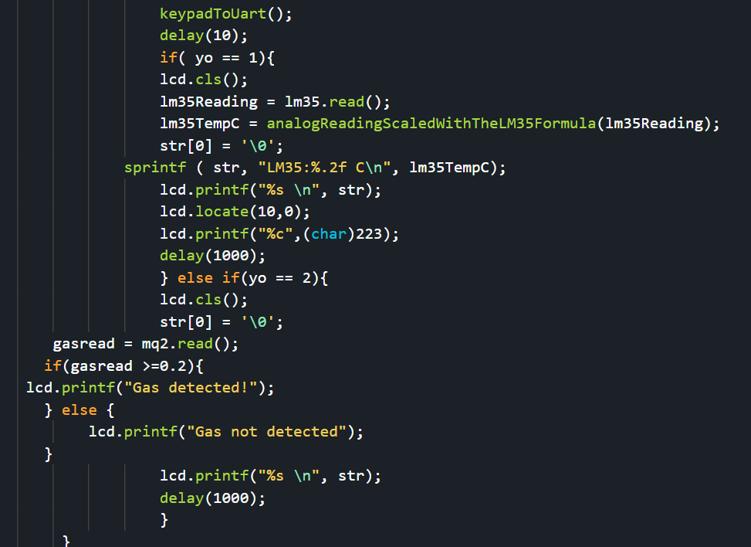
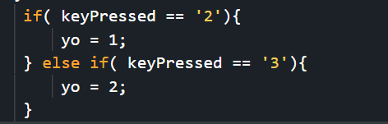
Embedded Systems Lab Worksheet
Student Name: Zeyad Karima
ID Number: 23077460
Lab. Number: Lab 6
Date: 02/05/2025
Lab Title:
Outline of Approach (Description of Tasks)
Itemize all key steps you took to build the required embedded system in a clear, logical and organised format.
1.Output the temp or gas depending on the keypad button
2.Output the alarm state at regular intervals
3.Continuasly output data onto the lcd about all sensor and alarm states
4.Trigger warning on lcd depending on alarm
5.Allow alarm to be turned off using a 4 digit code from the keypad
.
.
Reflection (Not more than 200 words)
I was able to make a code that outputs everything into a 20x4 LCD screen using a i2c library for the LDCD screen and my lab 5 code, ZeyadK05 (2025),.
This lab was a great one and made me feel excited as I was able to increase the skills I have while also finding some information online and using new libraries.
It was good to use my old code and to use a new library to create this code which works very well, the problem I had was with the spaces in between the screen as it was not able to understand the difference between a new line and an empty space so I had to change the cursor every time I write something on the lcd.
The situation was a great way to learn about output devices after using many sensors and input devices and has allowed me to expand my knowledge on electrical equipment.
Ive learned how to use new libraries, how to output on lcd screens, how to use ASCII code to find the symbols I need on a screen.
My plan is to continue finding useful libraries to increase the efficiency of my code making it simpler and easier.
Girhub with video evidence: https://github.com/ZeyadK05/Lab-6
Results for Part:1
(Input only lab results, Git-hub code link, Flow chart, calculations or picture evidence of simulation/circuits/figures obtained).
All figures should be captioned with relevant title and a brief description to present the essential details).
Check if key clicked is 2 or 3 in keypadtouart function then output onto the lcd screen, as the lcd can output string it was easy to output, the degree symbol does not work so I had to type it out as an ascii code.
References
Library used for LCD:
GitHub. (2021). sstaub/mbedLCDi2c: LCD HD44780 library with I2C adapter for Mbed 6. [online] Available at: https://github.com/sstaub/mbedLCDi2c [Accessed 4 May 2025].
ZeyadK05 (2025). GitHub - ZeyadK05/Lab-5: Keypad and passwords Lab-5. [online] GitHub. Available at: https://github.com/ZeyadK05/Lab-5 [Accessed 4 May 2025]

Slide 2
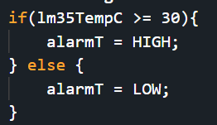
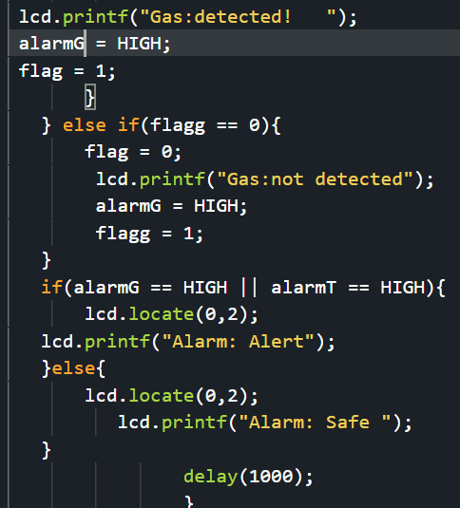
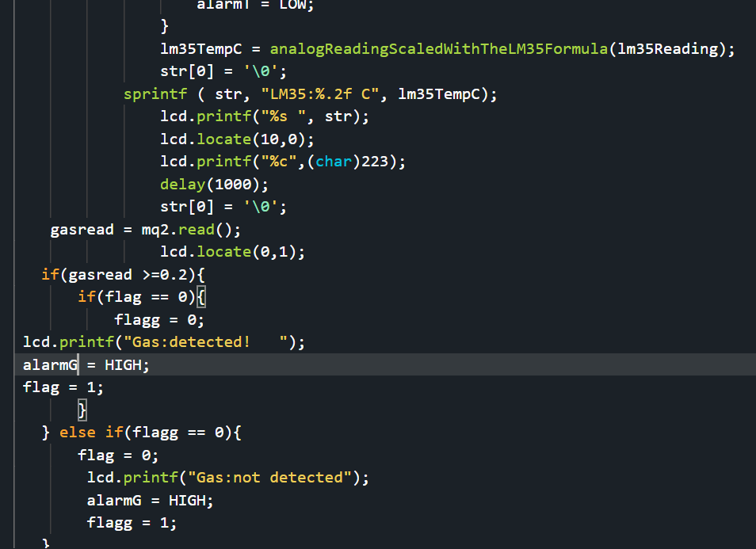
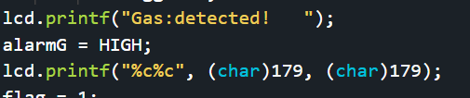
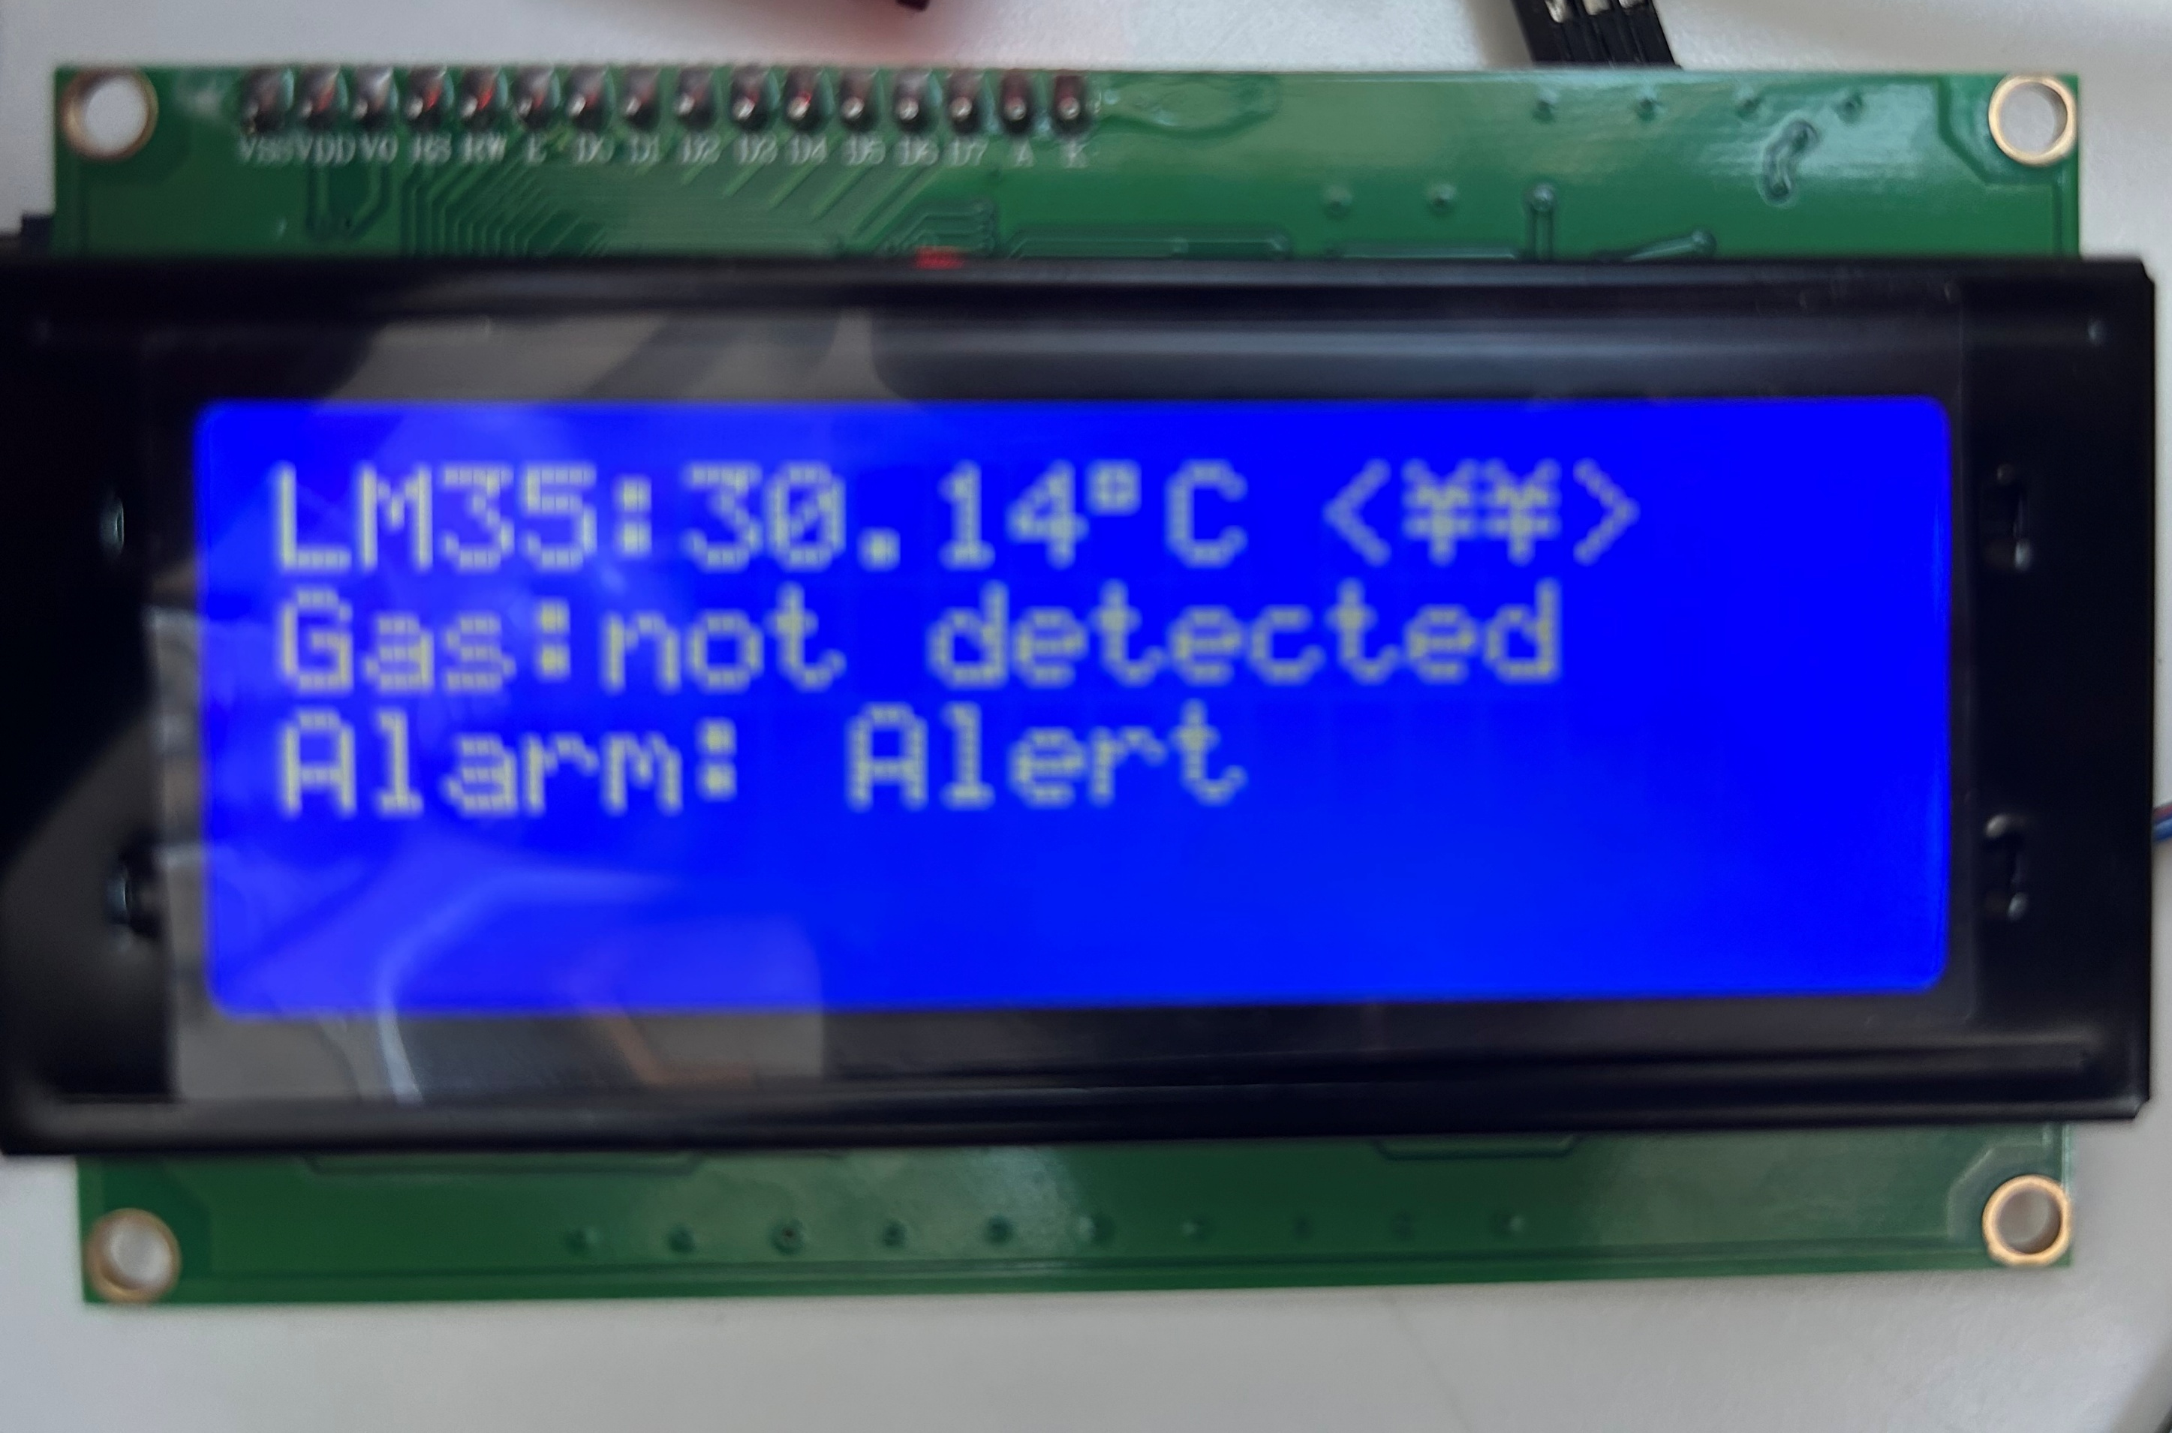
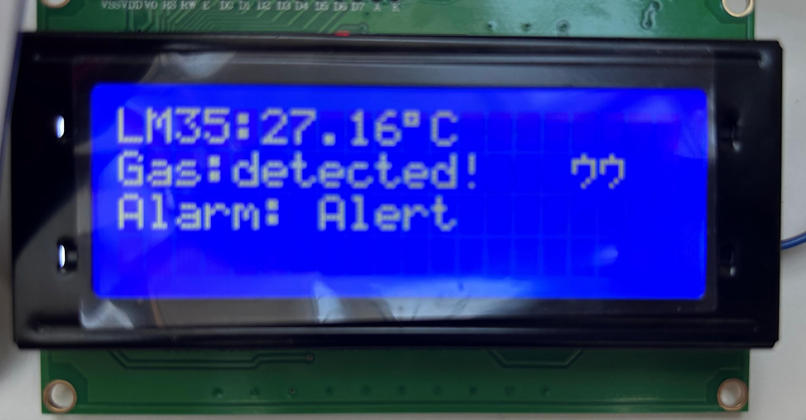
Results for Part:2
(Input only lab results, Git-hub code link, Flow chart, calculations or picture evidence of simulation/circuits/figures obtained).
All figures should be captioned with relevant title and a brief description to present the essential details).
Simple bolean alarm flag added and output on the third line of the LCD.
Results for Part:3
(Input only lab results, Git-hub code link, Flow chart, calculations or picture evidence of simulation/circuits/figures obtained).
All figures should be captioned with relevant title and a brief description to present the essential details).
Outputs the temperature, the gas detection status and the alarm status every second.
Results for Part:4
(Input only lab results, Git-hub code link, Flow chart, calculations or picture evidence of simulation/circuits/figures obtained).
All figures should be captioned with relevant title and a brief description to present the essential details).
Using ascii table to add symbols on the LCD depending on the alarm.

Slide 3
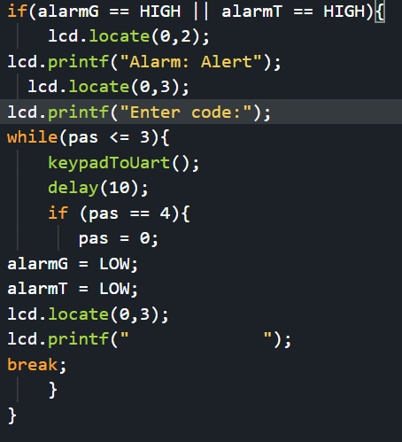
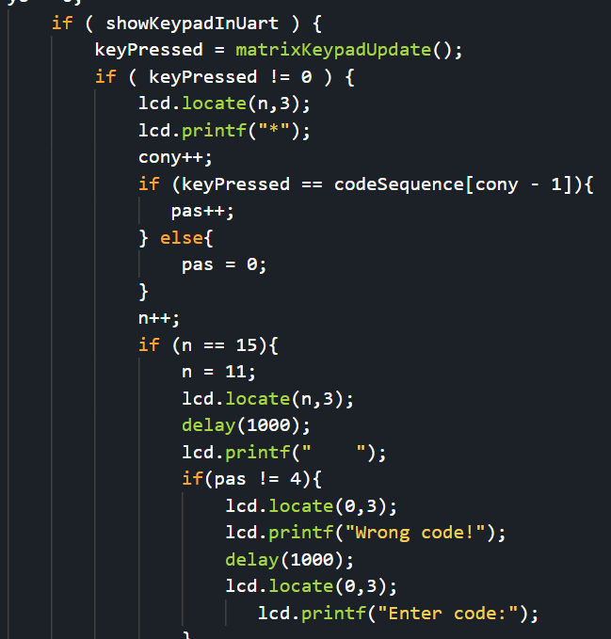
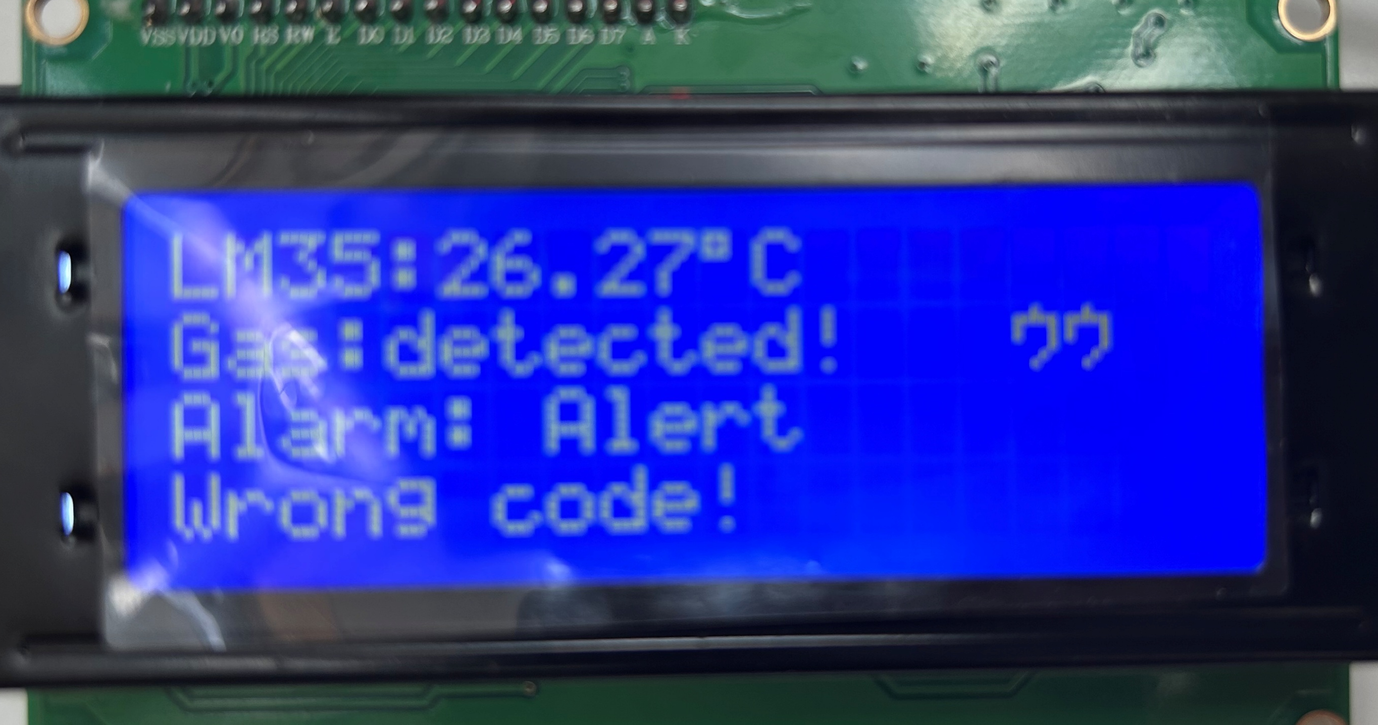
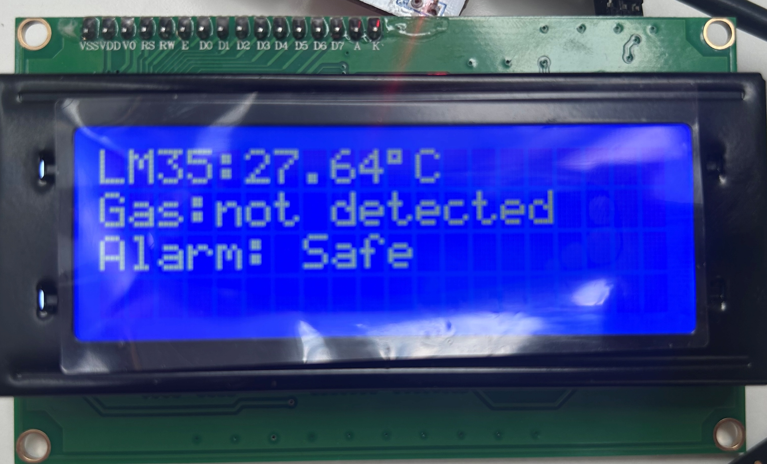
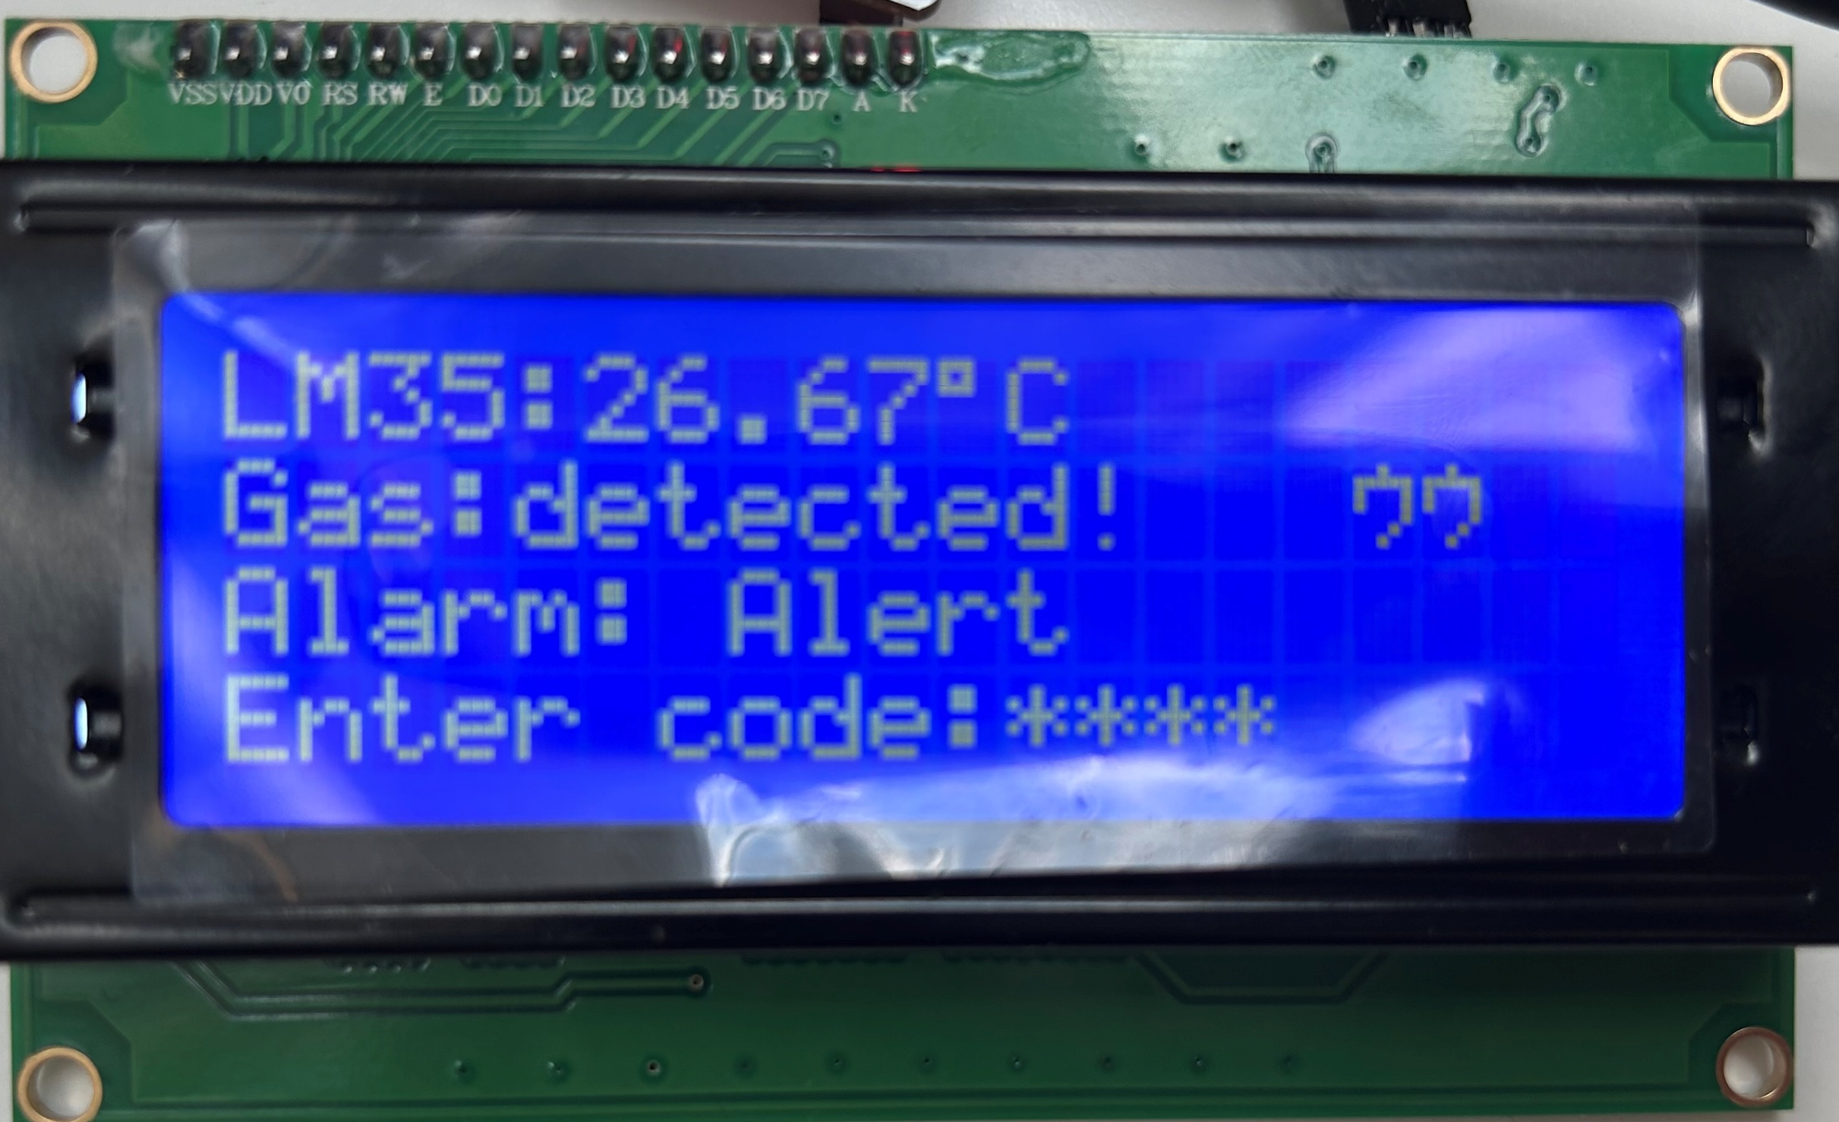
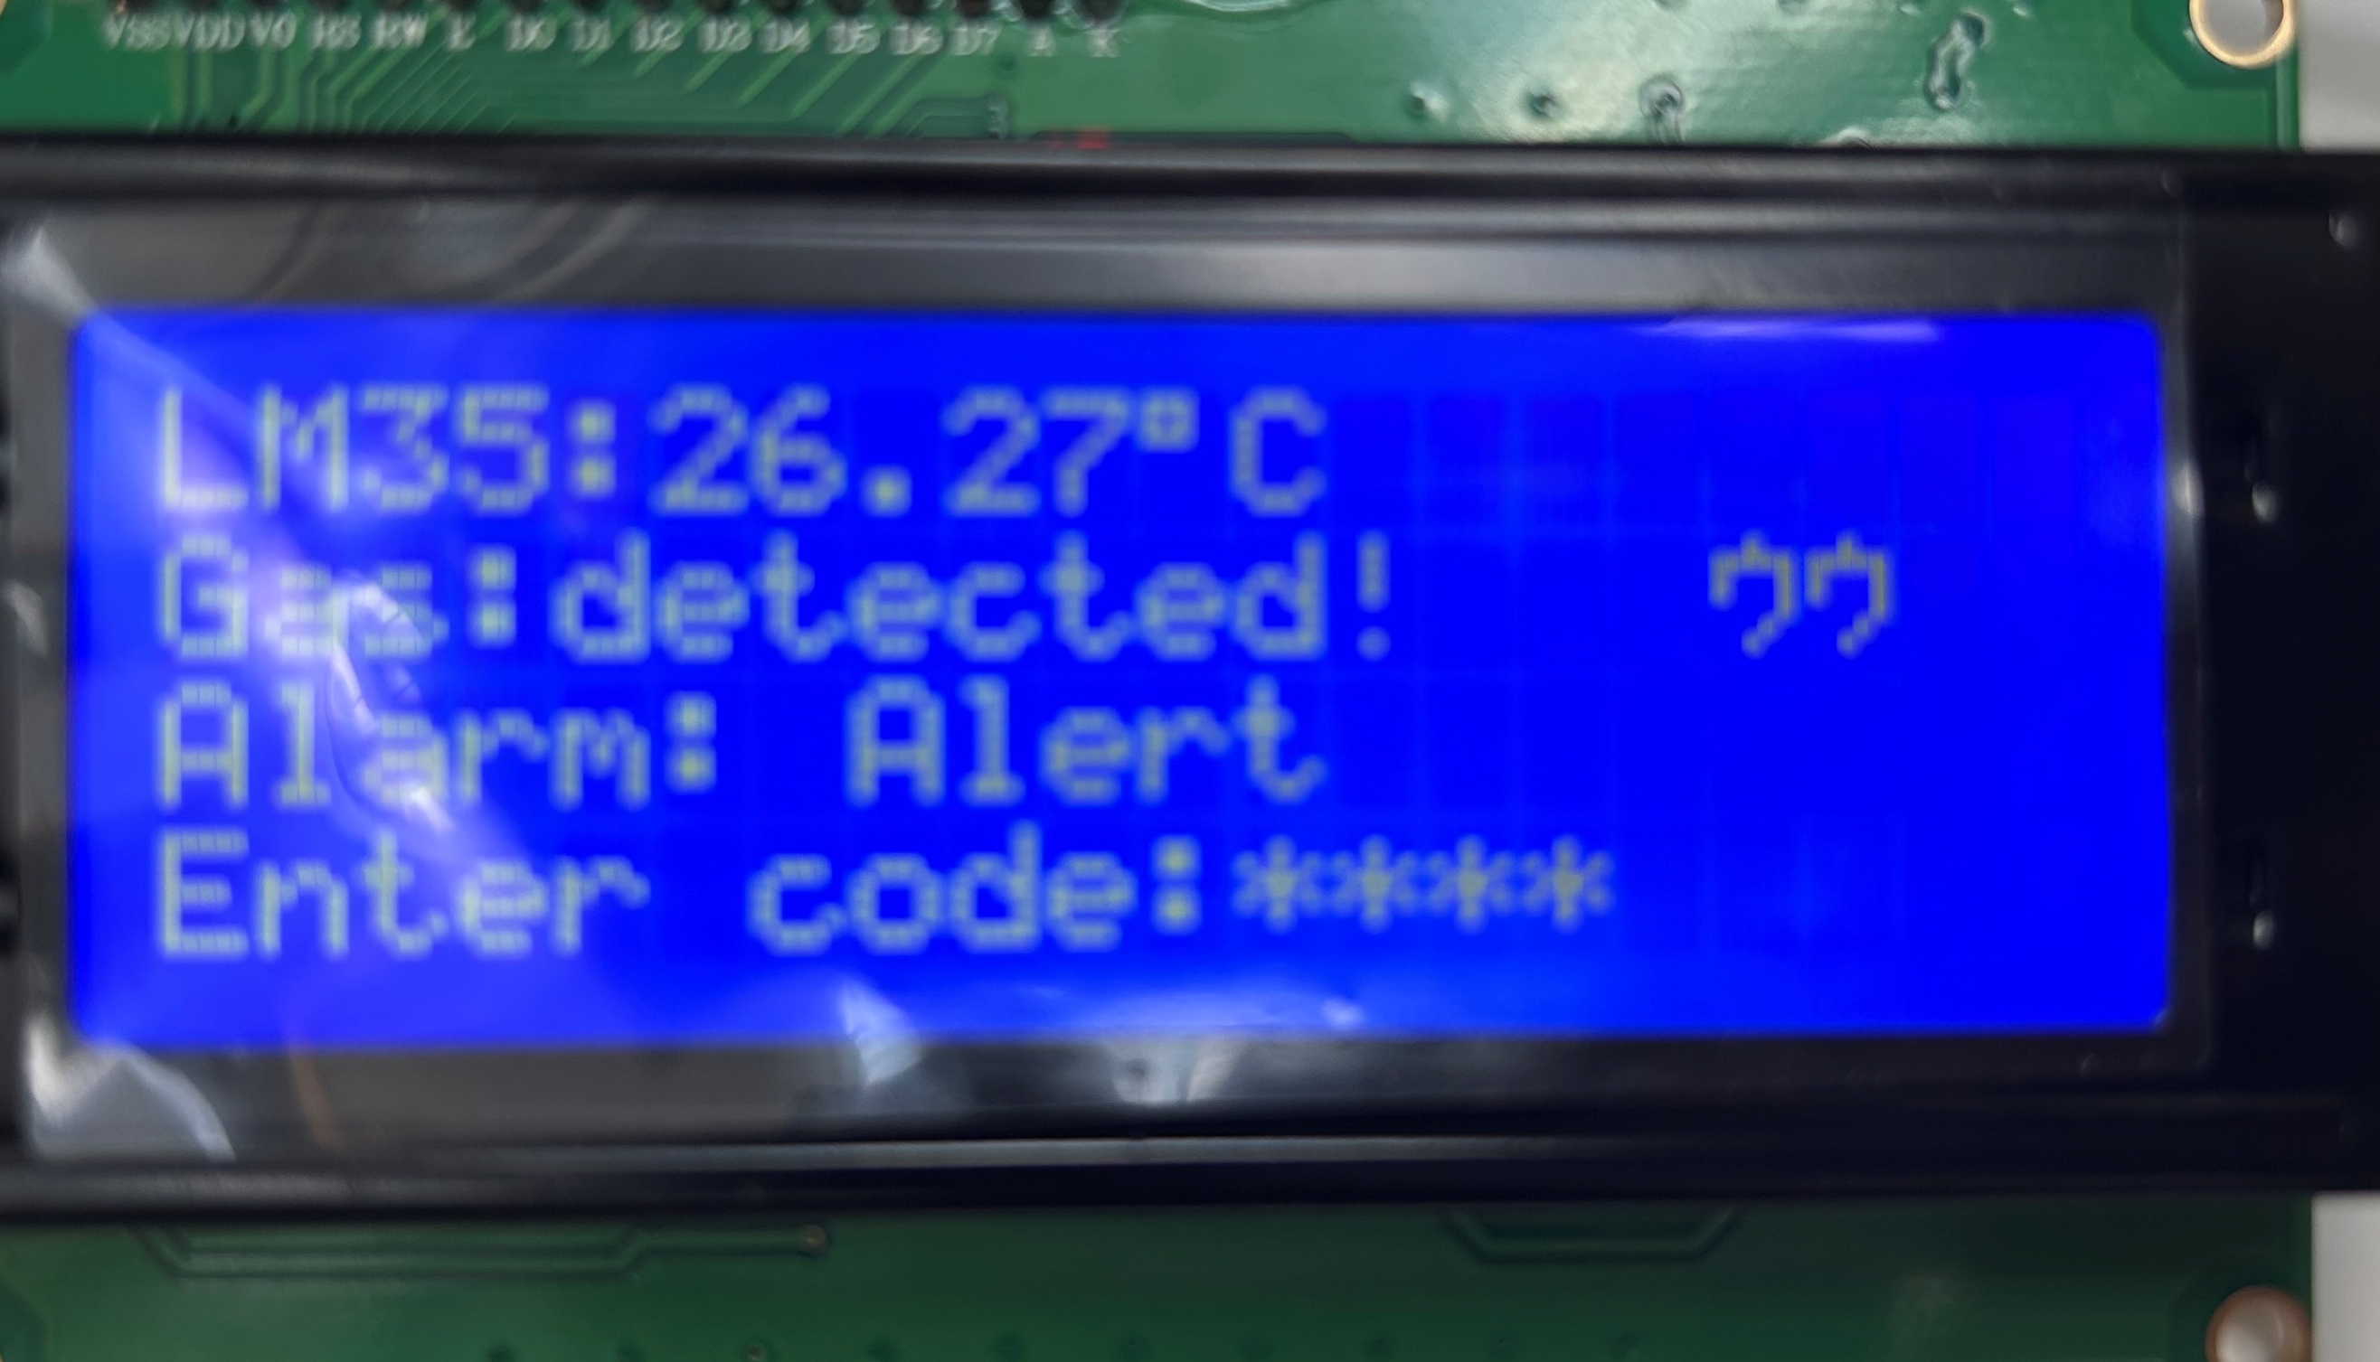
Results for Part:5
(Input only lab results, Git-hub code link, Flow chart, calculations or picture evidence of simulation/circuits/figures obtained).
All figures should be captioned with relevant title and a brief description to present the essential details).
.
Adding a while loop to read inputs from the keypad when alarm is activated, if code is entered correctly will turn off the alarm, if wrong code is entered it will output wrong code! And then ask for the code again.
Results for Part:5
(Input only lab results, Git-hub code link, Flow chart, calculations or picture evidence of simulation/circuits/figures obtained).
All figures should be captioned with relevant title and a brief description to present the essential details).
Results for Part:5
(Input only lab results, Git-hub code link, Flow chart, calculations or picture evidence of simulation/circuits/figures obtained).
All figures should be captioned with relevant title and a brief description to present the essential details).

